Slide 1
Third Party Libraries (Angular JS+Bootstrap+D3+jQuery)

Slide 2
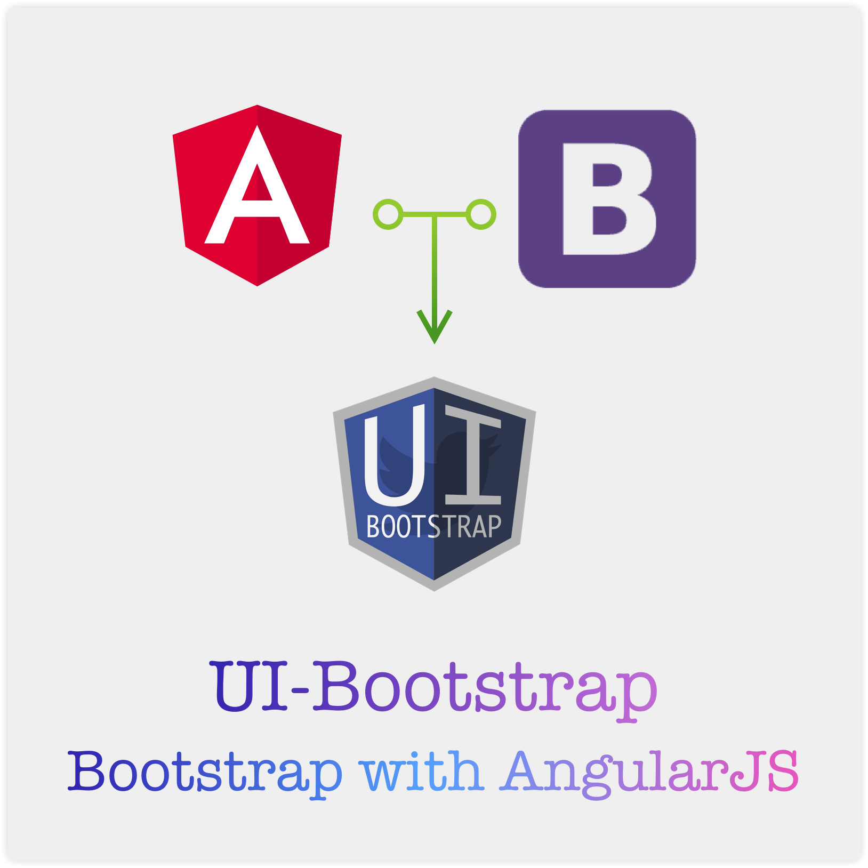
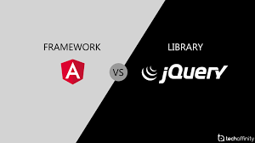
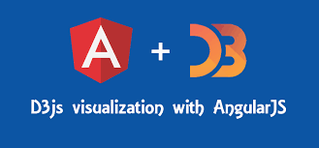

Slide 3
Agenda
Third party Libraries
Bootstrap
D3
jQuery

Slide 5
What is Bootstrap?
Bootstrap 4 is the newest version of Bootstrap, which is the most popular HTML, CSS, and JavaScript framework for developing responsive, mobile-first websites.
Bootstrap is a free front-end framework for faster and easier web development
Bootstrap includes HTML and CSS based design templates for typography, forms, buttons, tables, navigation, modals, image carousels and many other, as well as optional JavaScript plugins
Bootstrap also gives you the ability to easily create responsive designs

Slide 6
What is Responsive Web Design?
Responsive web design is about creating web sites which automatically adjust themselves to look good on all devices, from small phones to large desktops

Slide 7
Why Use Bootstrap?
Easy to use: Anybody with just basic knowledge of HTML and CSS can start using Bootstrap
Responsive features: Bootstrap's responsive CSS adjusts to phones, tablets, and desktops
Mobile-first approach: In Bootstrap, mobile-first styles are part of the core framework
Browser compatibility: Bootstrap 4 is compatible with all modern browsers (Chrome, Firefox, Internet Explorer 10+, Edge, Safari, and Opera)

Slide 8
Bootstrap 4 Containers
Containers are used to pad the content inside of them, and there are two container classes available:
The .container class provides a responsive fixed width container
The .container-fluid class provides a full width container, spanning the entire width of the viewport

Slide 9
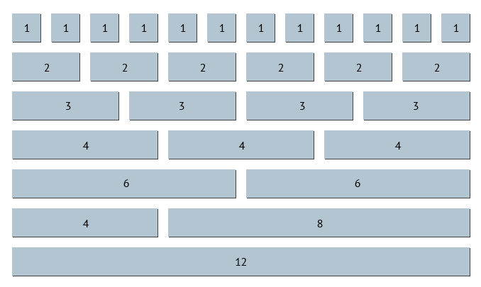
Bootstrap 4 Grids

Slide 11
Introduction
D3 stands for Data-Driven Documents. D3.js is a JavaScript library for manipulating documents based on data.
D3.js is a dynamic, interactive, online data visualizations framework used in a large number of websites.
D3.js is written by Mike Bostock, created as a successor to an earlier visualization toolkit called Protovis.

Slide 12
Data visualization
Data visualization is the presentation of data in a pictorial or graphical format.
The primary goal of data visualization is to communicate information clearly and efficiently via statistical graphics, plots and information graphics.
Data visualization helps us to communicate our insights quickly and effectively.
Any type of data, which is represented by a visualization allows users to compare the data, generate analytic reports, understand patterns and thus helps them to take the decision.
Data visualizations can be interactive, so that users analyze specific data in the chart.

Slide 13
What is D3.js?
D3.js is a JavaScript library used to create interactive visualizations in the browser.
The D3.js library allows us to manipulate elements of a webpage in the context of a data set.
These elements can be HTML, SVG, or Canvas elements and can be introduced, removed, or edited according to the contents of the data set.
It is a library for manipulating the DOM objects. D3.js can be a valuable aid in data exploration, it gives you control over your data's representation and lets you add interactivity.

Slide 14
Features of D3.js
Code Reusability
Declarative Programming
Large Datasets Support
Fast and efficient to use
Extremely Flexible
Includes curve producing function's wide variety
In an HTML page, relates data to the components and group of components

Slide 15
Benefits of D3.js
DOM manipulation
Strong data visualization
Efficient to build any charting component
D3.js is modular. We can download any small part of D3.js that we wish to use.
There is no requirement to load an entire library all the time.

Slide 16
Web Standards of D3.js
HTML (Hyper Text Markup Language)
DOM (Document Object Model)
CSS (Cascading Style Sheet)
SVG (Scalable Vector Graphics)
JavaScript

Slide 17
Animation in D3.js
D3.js provides its support to animation by the transition. We may create animation along with a good application of transition.
The transition is any limited pattern of the Key Frame Animation along with two of the essential keyframes, which are start and end.

Slide 19
jQuery
jQuery is a JavaScript Library.
jQuery greatly simplifies JavaScript programming.
jQuery is easy to learn.

Slide 20
What is jQuery?
jQuery is a lightweight, "write less, do more", JavaScript library.
The purpose of jQuery is to make it much easier to use JavaScript on your website.
jQuery takes a lot of common tasks that require many lines of JavaScript code to accomplish, and wraps them into methods that you can call with a single line of code.

Slide 21
The jQuery library contains the following features:
HTML/DOM manipulation
CSS manipulation
HTML event methods
Effects and animations
AJAX
Utilities

Slide 22
Why jQuery?
There are lots of other JavaScript libraries out there, but jQuery is probably the most popular, and also the most extendable.
Many of the biggest companies on the Web use jQuery, such as:
Google
Microsoft
IBM
Netflix

Slide 23
jQuery Syntax
The jQuery syntax is tailor-made for selecting HTML elements and performing some action on the element(s).
Basic syntax is: $(selector).action()
A $ sign to define/access jQuery
A (selector) to "query (or find)" HTML elements
A jQuery action() to be performed on the element(s)

Slide 24
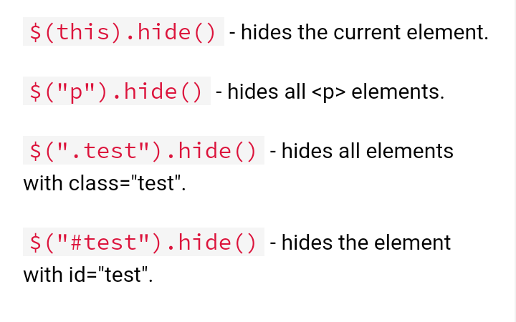

Slide 25
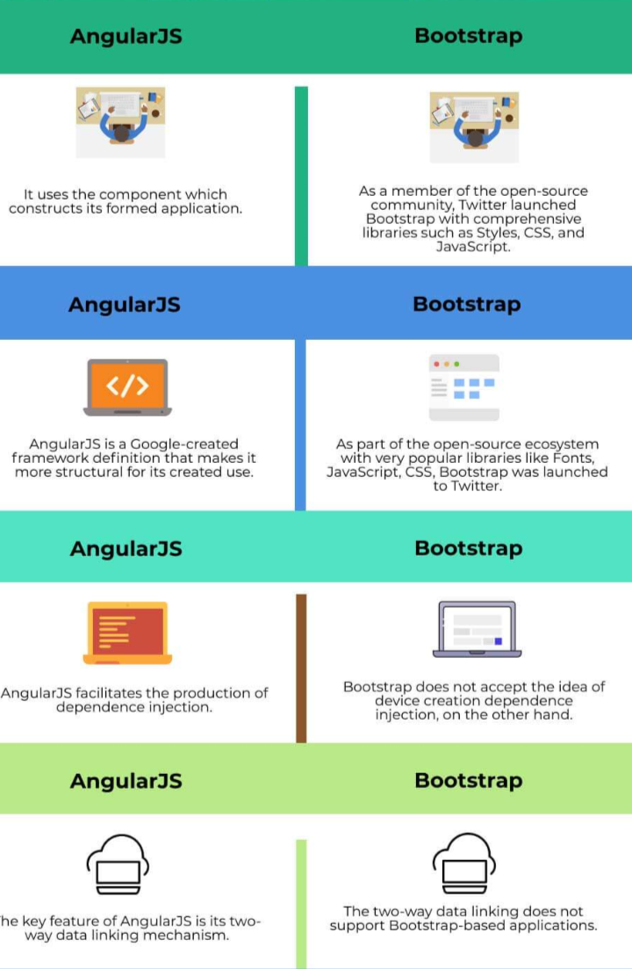

Slide 26
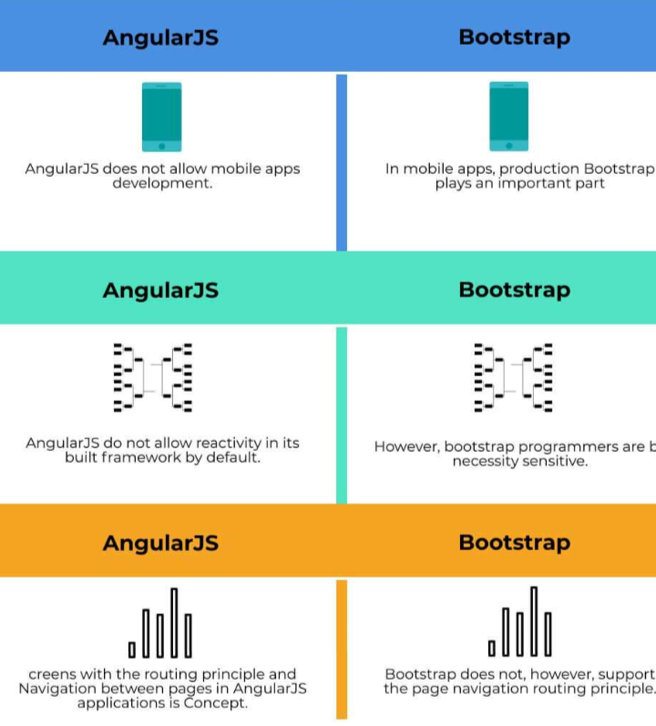

Slide 27
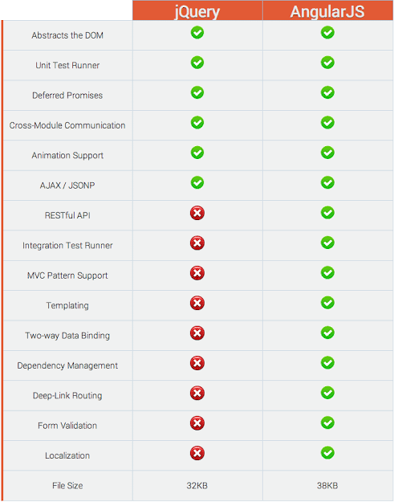

Slide 28
THANK You...

